Slide 1
GROUP 4 AI-DRIVEN LLM AUTOMATION AGENT FOR DATA WORKFLOW
Team Members:
Anjali Garg, Basil John Milton M, Karishma Kamble, Mohan Kumar Areti,
Yun (Hailey) Wu
Faculty Advisor: Professor Fatemah Sarayloo
CCC Project Manager: Gelareh Kalantari
CCC Mentors: Maryam Moghimi, Prateek Burman
DEC 2024

Slide 2
Introduction
CCC Intelligent Solutions, founded in 1980, is a technology leader providing solutions for insurers, automotive manufacturers, and repair facilities.
The company seeks to leverage automation and AI to streamline workflows, reduce costs, and enhance efficiency.
Project Overview:
Develop an AI agent using Large Language Models (LLMs) to automate vehicle data retrieval from multiple online sources, streamlining the evaluation process.
The agent performs searches across various websites, retrieving and presenting data, thereby reducing the effort of manual data retrieval for CCC employees conducting post-accident vehicle assessments.

Slide 3




BUSINESS PROBLEM
Accurate Data Retrieval
Ensure reliable extraction of product and vehicle data with error handling for dynamic and static websites.
Extract precise information from PDFs and web pages to minimize inaccuracies in the results.
Support for Vehicle Valuation
Provide detailed specifications and features to aid in market valuation of commercial and recreational vehicles.
Enable customization of searches by vehicle features and product descriptions to support informed decision-making.
Adaptability
Integrate modular tools to handle varied data sources and formats seamlessly.
Facilitate easy expansion for additional queries, tools, or workflows as requirements evolve.
Data Aggregation
Identify data sources such as output from web pages and PDFs, and format the retrieved data into a user-friendly output accordingly.
Present information in structured formats like tables or summaries for better decision-making.

Slide 4
ANALYTICAL PROBLEM
AI Agent System: Build an adaptive AI-driven tool that not only retrieves data but also integrates and processes it to meet varying requirements and streamline the workflow.
Accuracy and Efficiency: Develop a system that guarantees precise data extraction while optimizing processing speeds, enabling CCC employees to make informed decisions quickly and effectively.
Intelligent Data Retrieval: Automate the extraction of relevant data from multiple online sources, minimizing manual effort and ensuring accurate, fast retrieval for evaluations.

Slide 5
Methodology
1. Technology and Framework Selection
Choosing the right frameworks, libraries, and tools to implement the functionality efficiently.
Framework: Langgraph for managing workflows with scalable integration.
LLM: Anthropic Claude LLM for robust query parsing, tool selection, and output formatting.
Web Scraping: Selenium for dynamic web scraping and BeautifulSoup for lightweight HTML parsing.
PDF Extraction: pdfplumber for accurate text extraction.
Interface: Streamlit for an interactive system interface.
2. Component Development and Workflow Design
Core components were developed for functionality and integrated into a cohesive system.
Workflow Management: Langchain, Langgraph & LLM: Enabled query parsing, tool invocation, and workflow tracking with StateGraph, integrating tools via ToolNode and ensuring state persistence with MemorySaver.
Web Scraping Tool: Dynamically constructed search URLs and retrieved product data using Selenium and BeautifulSoup with Edge WebDriver.
PDF Data Extraction Tool: Generated URLs, fetched pages, identified PDF links, and extracted text using pdfplumber.
3. Testing, Optimization, and Deployment
The system underwent rigorous testing and optimization to ensure reliability and performance:
Unit and Workflow Testing: Individual tools and end-to-end workflows were tested to validate accuracy, error handling, and seamless integration.
Performance Optimization: Streamlined web scraping and PDF extraction logic for efficiency and faster processing.
Deployment: The final system was deployed using Streamlit, providing an interactive chatbot interface for real-time user queries and results.

Slide 6
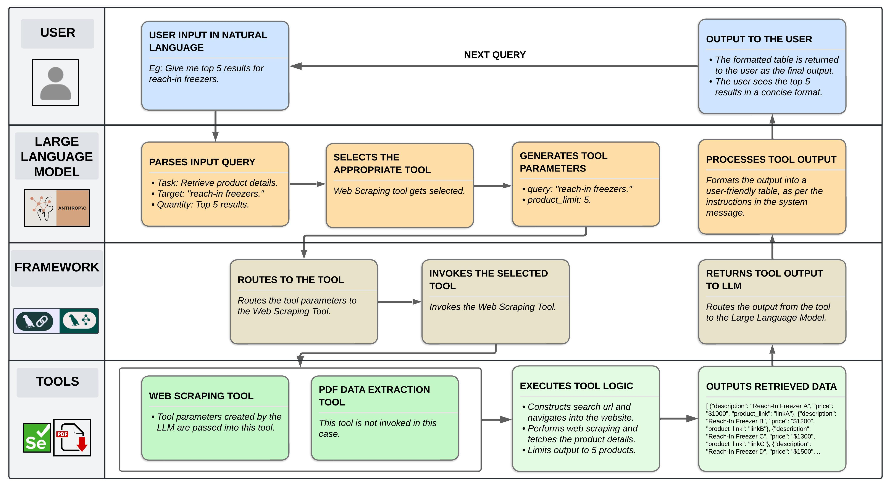
Workflow

Slide 7
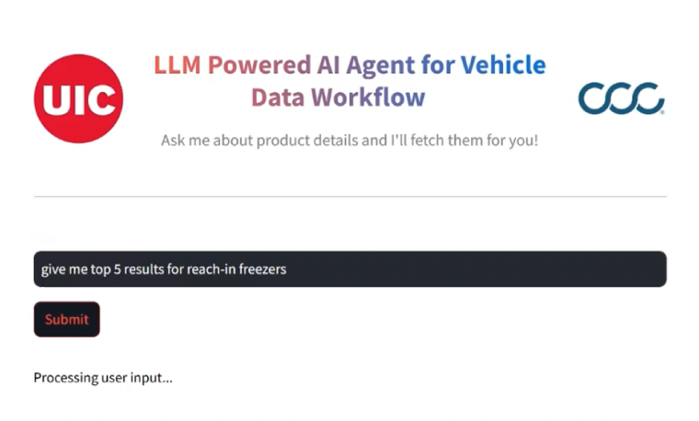
UI Demo

Slide 8
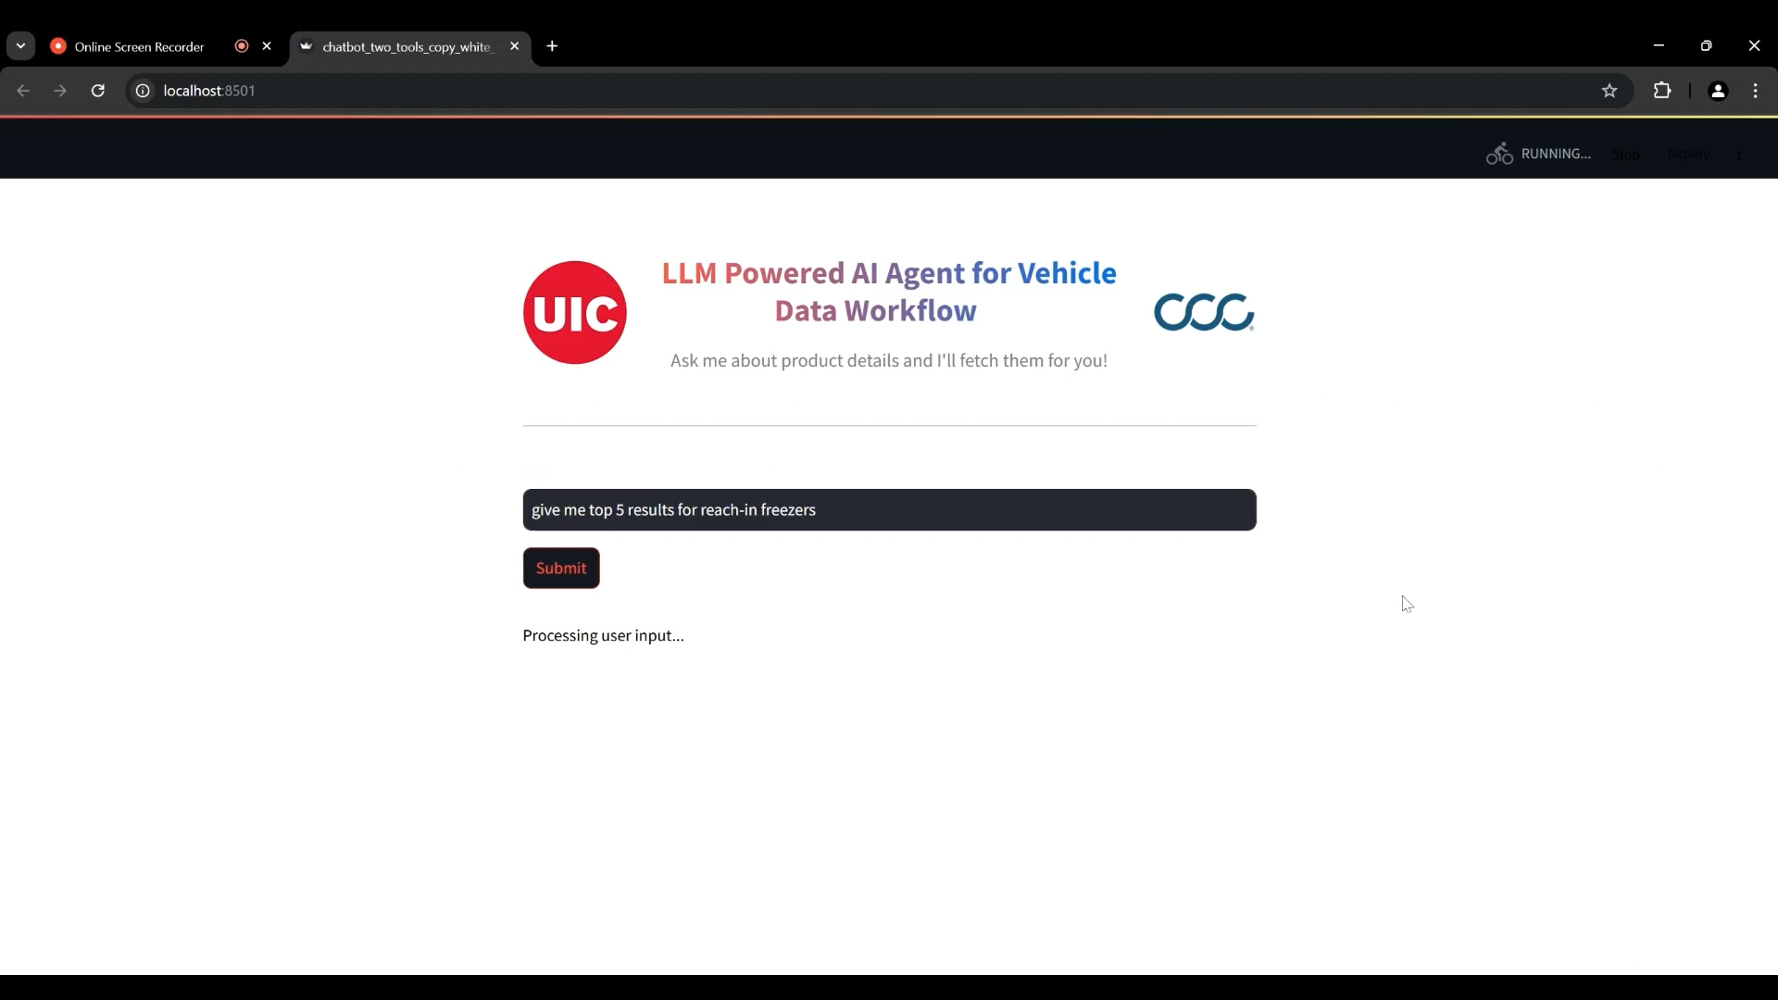
Results: UI Demo

Slide 9
Challenges
Web Scraping
Challenge:
The task involved retrieving data from multiple websites, which posed challenges such as captchas, website restrictions, and compliance with legal requirements.
Solution:
Data scraping is limited to websites that explicitly permit it, ensuring adherence to legal and ethical guidelines.
Future Plan:
Acquire API access from restricted websites, enabling direct and efficient data retrieval while addressing compliance and operational challenges.
Handling Dynamic Data
Challenge:
Effectively managing both structured and unstructured data from various sources while presenting it in a format that is user-friendly.
Solution:
Carefully designed prompts ensure the LLM processes these data types effectively and generates organized, readable outputs for users.
Future Plan:
With the integration of APIs in the future, the data handling process will be streamlined across tools, simplifying the management of dynamic data.
Data Accuracy
Challenge:
Ensuring that the data retrieved by the system is both accurate and relevant, avoiding incomplete or misleading information.
Solution:
The output was validated against website data for accuracy, and the agent was programmed to provide explicit error messages to prevent hallucinated outputs when tools fail.
Future Plan:
With API access, data will be sourced directly from trusted systems, eliminating the need for manual validation and error-checking processes, thereby enhancing reliability.

Slide 10
Results
2. Data Accuracy
Validation during testing confirmed that the agent provides accurate data aligned with the source websites 90% of the time, ensuring reliability for decision-making.
3. Output Formatting
The LLM successfully delivers dynamically formatted outputs in the desired format 100% of the time, ensuring consistency and user satisfaction.
1. Query Processing Time
Manual Browsing: Takes an average of 20 seconds (range: 10–30 seconds).
AI Agent: Takes an average of 12.5 seconds (range: 10–15 seconds).
Reduction in the average query processing time by approximately 37.5% improving efficiency.

Slide 11
Conclusion
Enhanced Reliability
By leveraging LLMs and robust validation mechanisms, the system ensures reliable and user-friendly outputs.
Adaptability and Integration
Enables seamless integration of additional tools and data sources, ensuring the system remains flexible to evolving requirements.
Streamlined Workflow
The AI agent effectively automates data retrieval, reducing manual effort and enhancing efficiency for CCC employees.
FUTURE VISION: Build a multi-agent system for vehicle data retrieval, integrating multiple tools and LLMs. This system will enable LLMs to interact with each other, enhancing decision-making and providing more accurate and efficient outputs for CCC employees.

Slide 12
“Accelerating Success with the Power of AI.”

